Slide 1
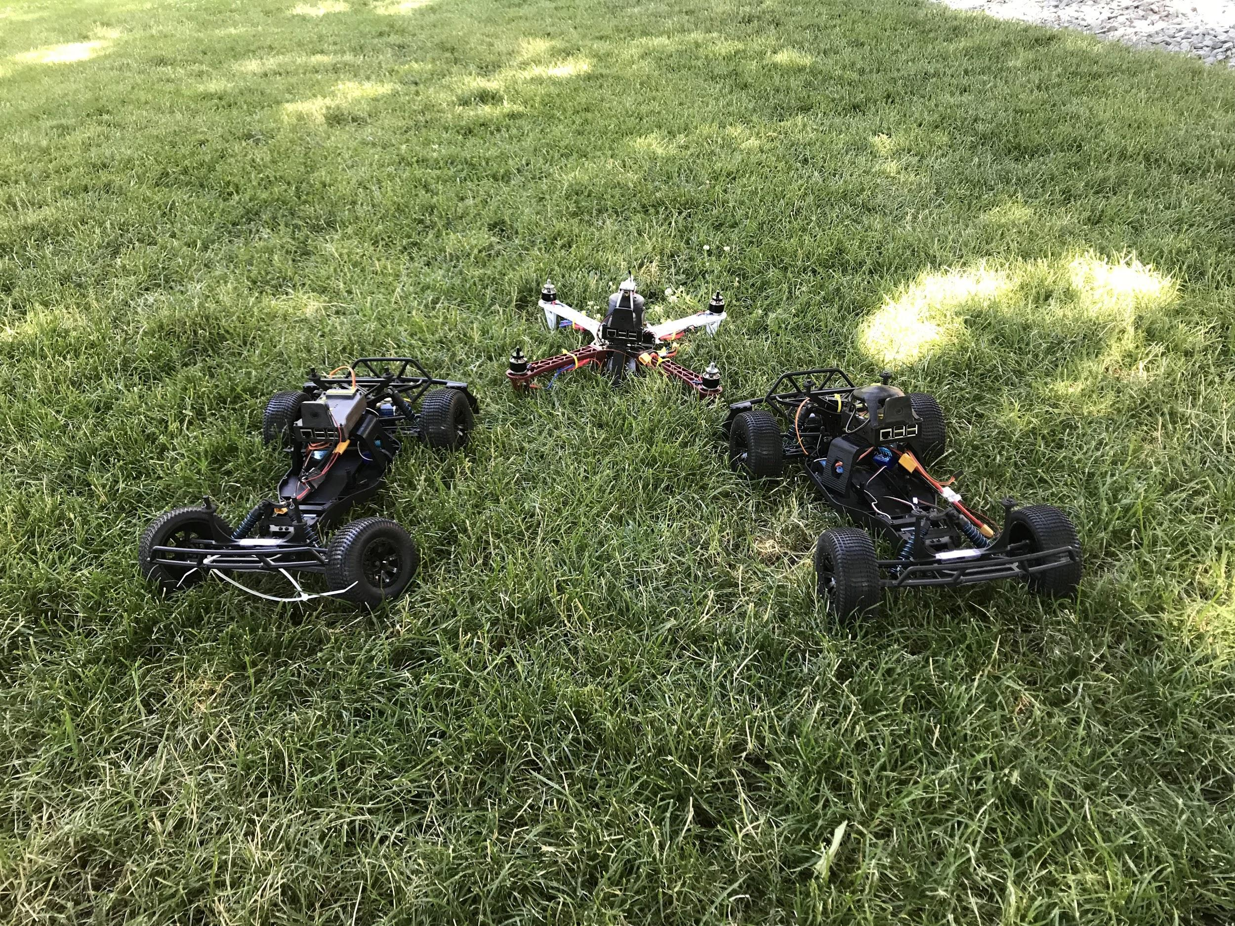
Tristan Brodeur, Paulo Regis,
David Feil-Seifer, Shamik Sengupta
Search & Rescue Operations ::
Mesh Networked Robotics

Slide 2
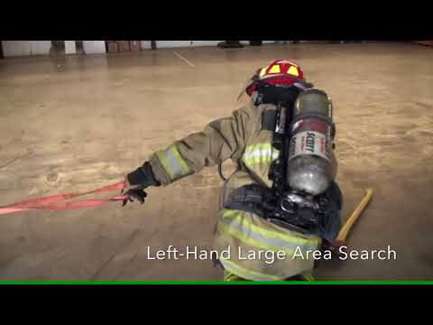
Goal
Large-area search-and-rescue techniques are of primary concern in disaster relief efforts.

Slide 3
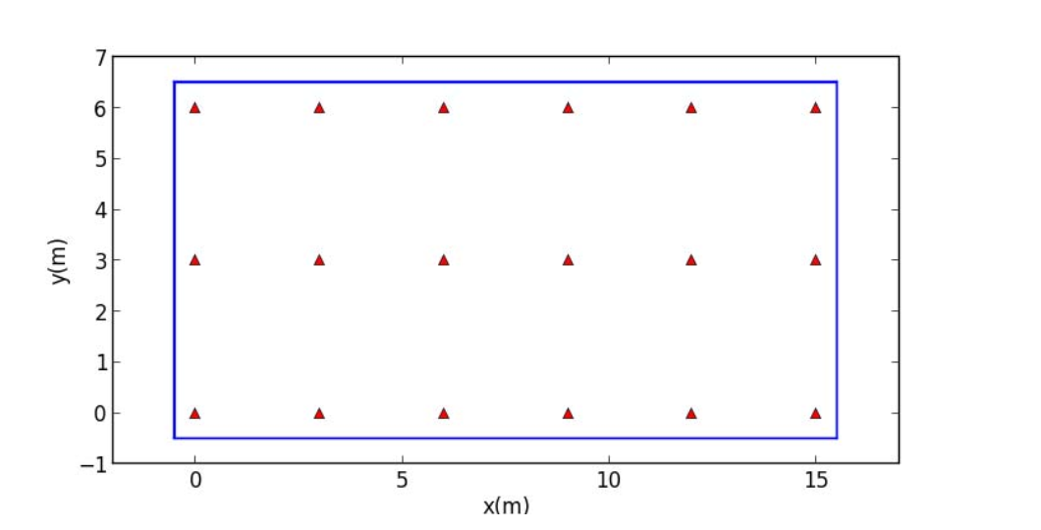
Mesh Networks
Follow-the-leader approach based on wifi-geolocation [2]
Each slave node determines velocity commands via communicated velocities from master node
IEEE 802.11 devices often make the RSSI measurement available to users
Navigation of unknown terrain from statically placed nodes configured in mesh network [1]
[1] N. Zhou, X. Zhao, M. Tan
RSSI-based Mobile Robot Navigation InGrid-pattern Wireless Sensor Network
Chinese Automation Congress; November, 2013.

Slide 4
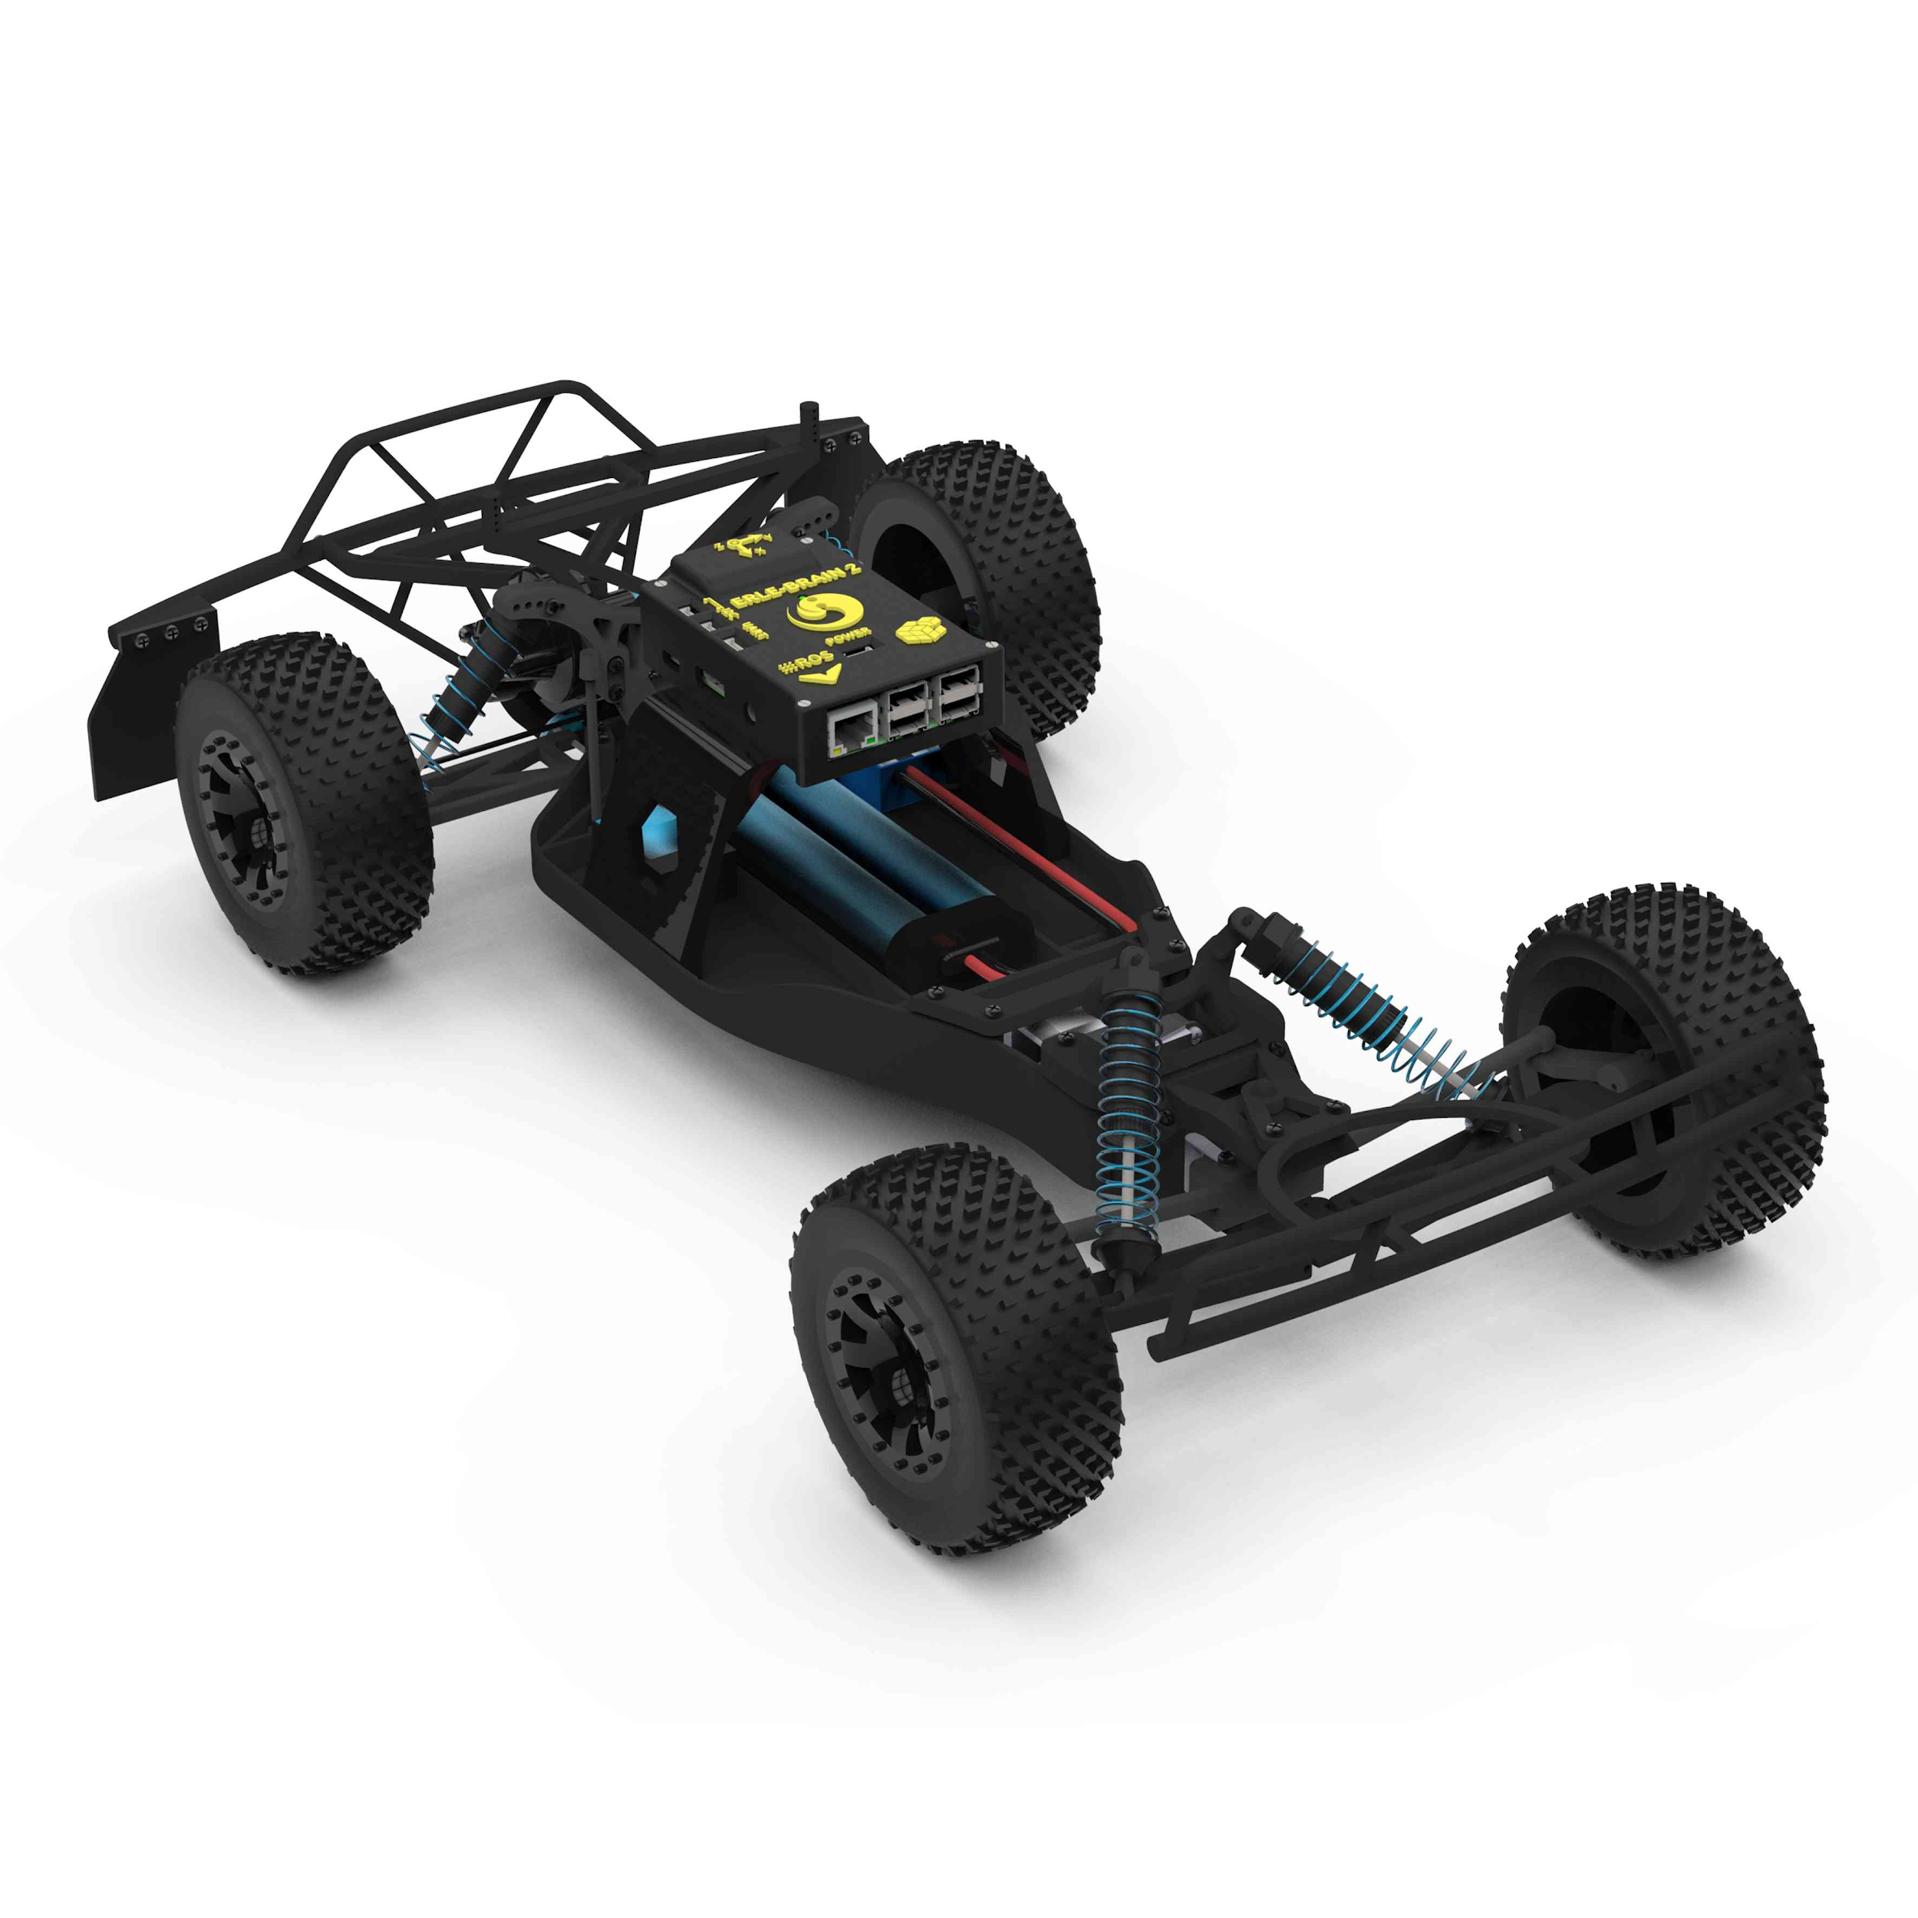
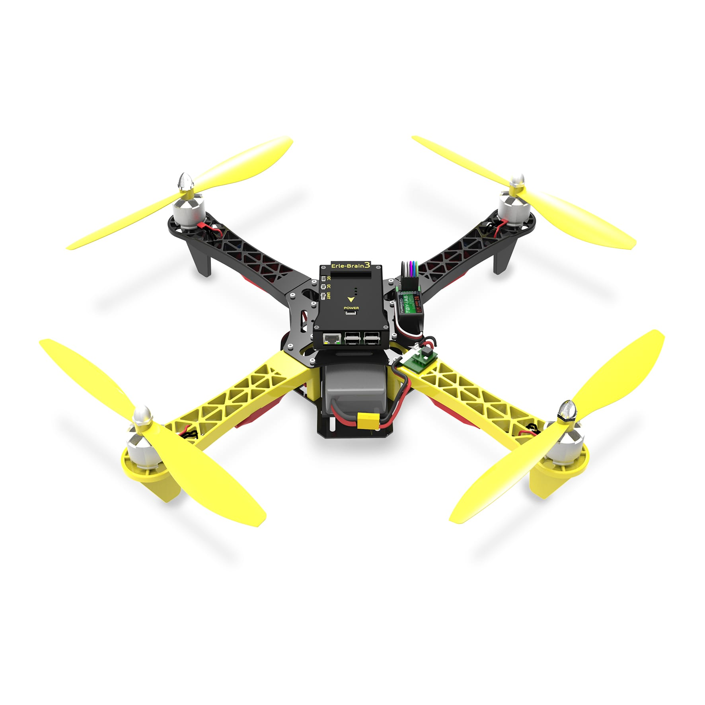
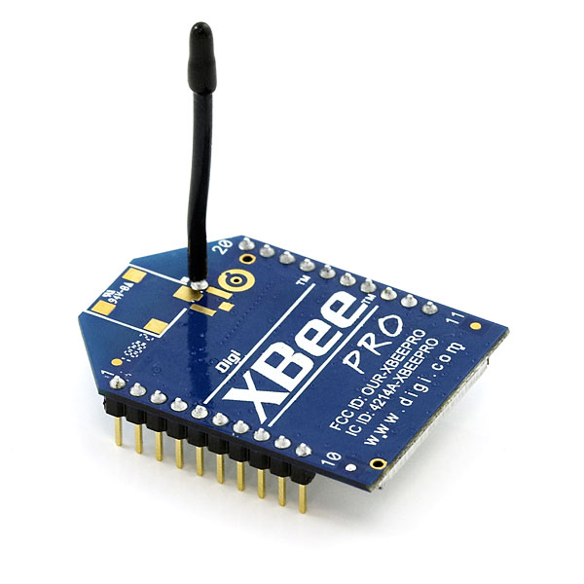
Methods ::
Equipment
x2
x3

Slide 5
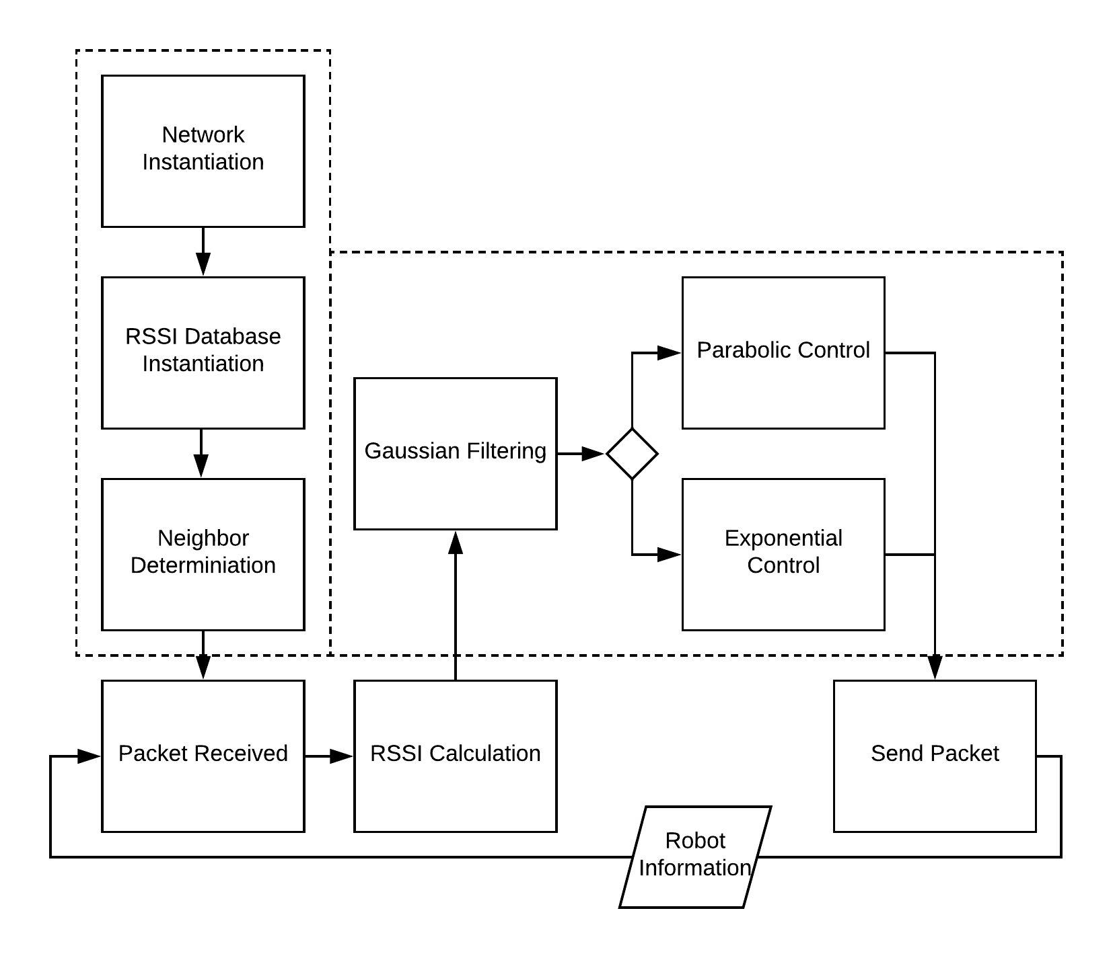
Approach ::
Node Initialization
Propagation of RSSI values to each node in system
RSSI database created of all nodes contained within the system

Slide 6
Approach ::
RSSI Thresholding
Packet sent at each time stamp containing the following data:
P(x) : threshold value determining critical point
μ : average of all received RSSI values for a particular node within a determined time frame
σ² : variance of the received RSSI values
Identification Number
Time-to-failure (based on battery status)
RSSI respective to requesting nodes
Status of mission

Slide 7
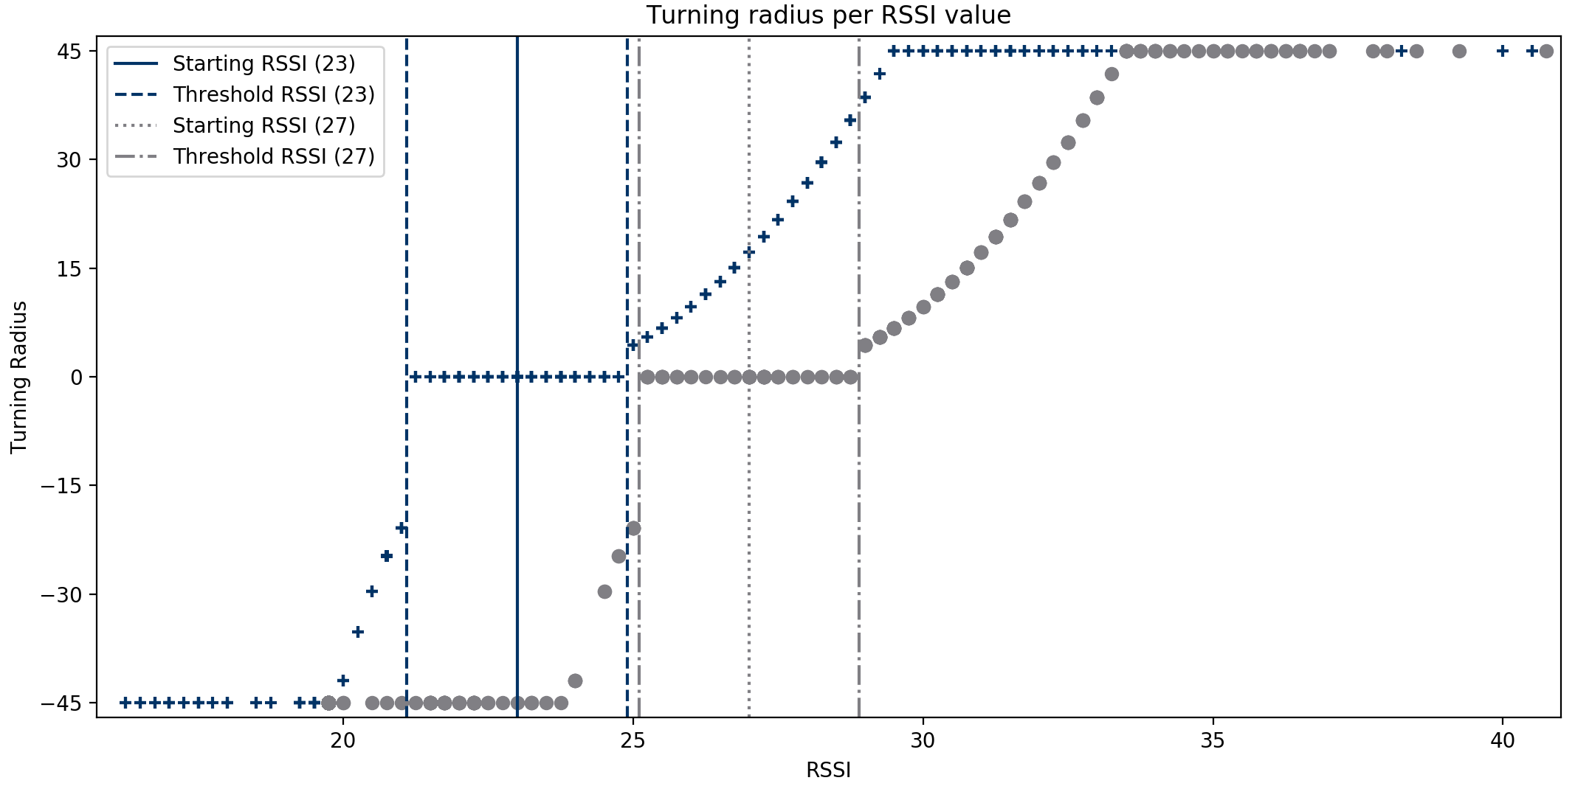
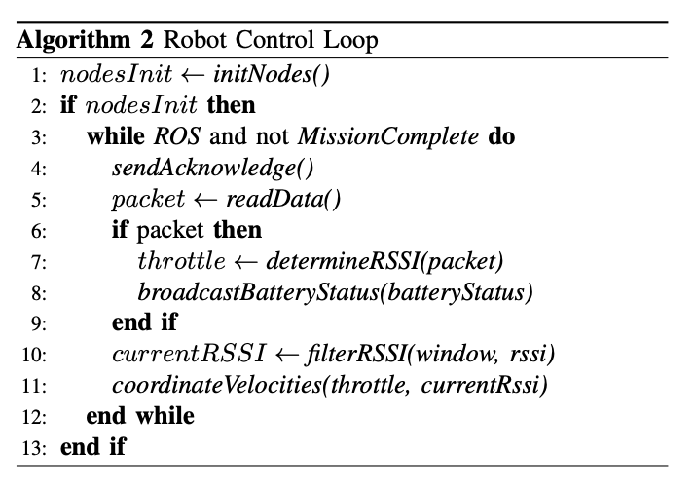
Approach ::
Robot Control

Slide 8
Results
Measured Time Requirements for Instantiation
Initial Positioning Accuracy for n+1 nodes

Slide 9
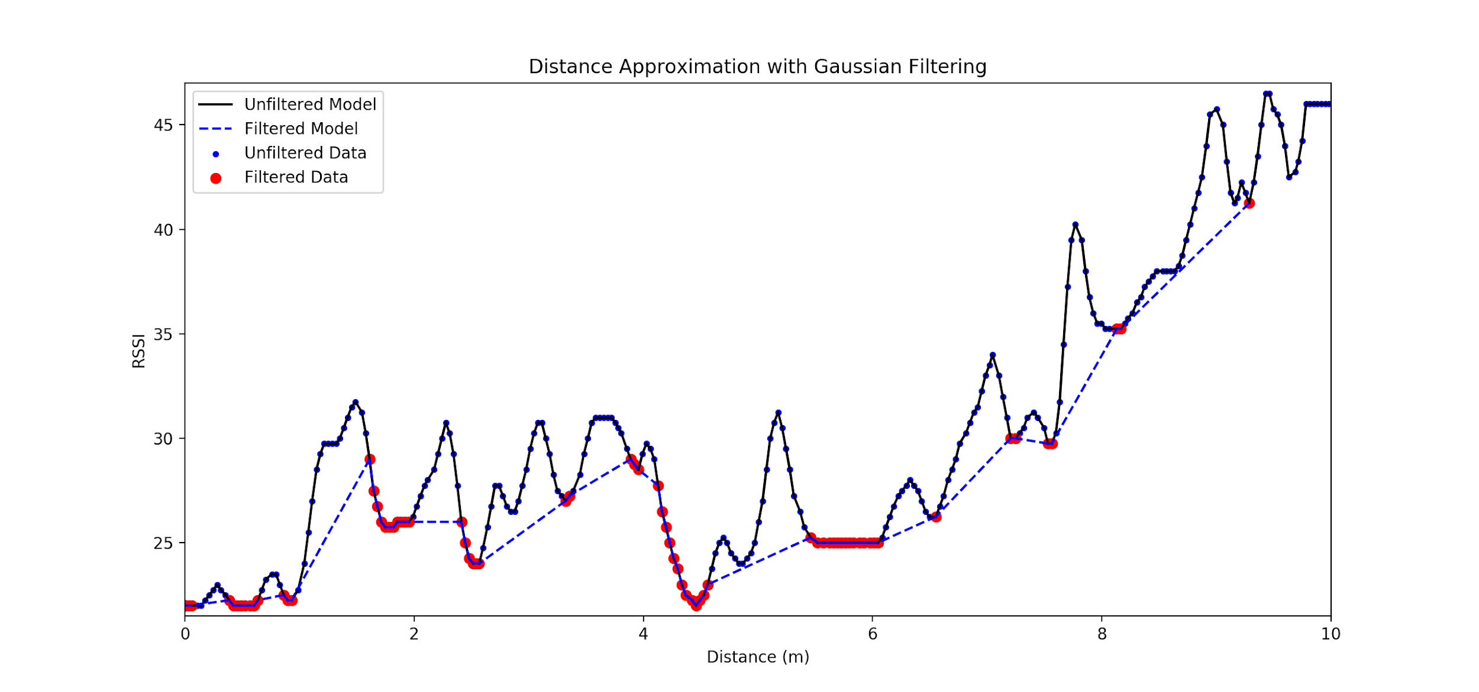
Results

Slide 10
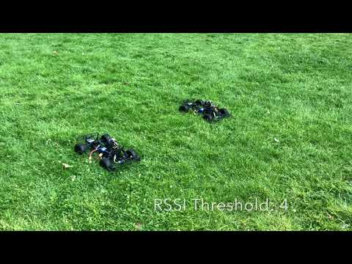
Results

Slide 11
Conclusions
& Future Work
Robots under certain thresholding techniques are able to stay aligned
Refined filtering method increased the accuracy of the system, but a more appropriate filtering technique would assist greatly
Future Work: Ability for the system to learn parameters needed to increase the accuracy of the system (as compared to simulation).
This work supported by the National Science Foundation under award number IIS-1757929
Thank you!

